Slide 2
Class 16
Modalities: Spreadsheets

Slide 3
Logistics
If you are sick, talk to me to arrange a special-case zoom
A4 released later today (use #A4 channel on slack)

Slide 4
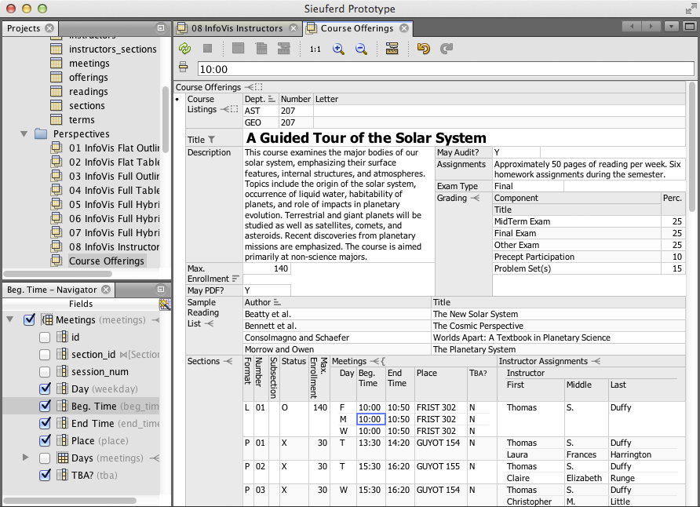

Eirik Bakke: Spreadsheets

Slide 5
Each group assigns notetaker
Our model of HDIs is based on language (expressiveness), task, visual representation, and interactions.
Contrast two spreadsheet systems from A3 in terms of our model.
Notes:
How did you pick the other vis language?

Slide 6
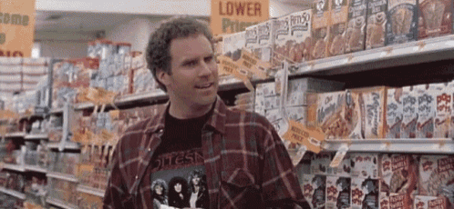
Support your colleagues
for speaking up!

Slide 7
Each group assigns notetaker
Our model of HDIs is based on language (expressiveness), task, visual representation, and interactions.
Contrast two spreadsheet systems from A3 in terms of our model.
Notes:
How did you pick the other vis language?

Slide 8
Class 15
Modalities: Voice and Text

Slide 9
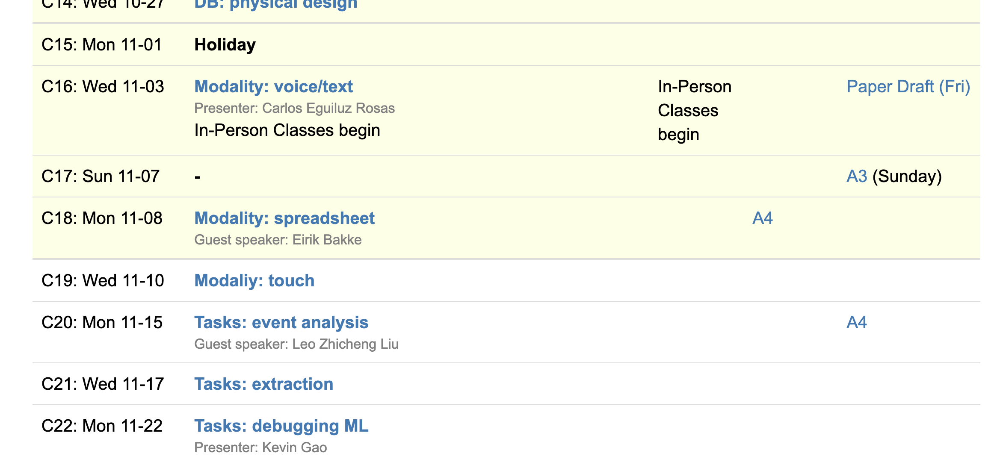
Logistics
Drafts due Friday
A3 due Sunday
A4 out next week
Eirik on Monday

Slide 10
Class 14
Physical Design

Slide 11
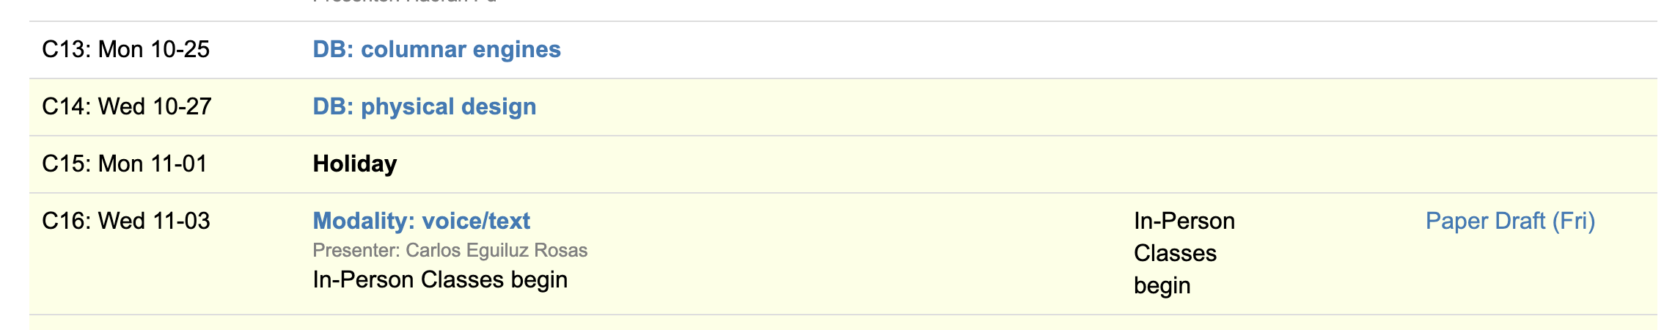
Logistics
In-person-only on Nov 3 after election holiday
Office hours Thursday 1pm (next week only)
Final class on performance
VIS today to Friday

Slide 12
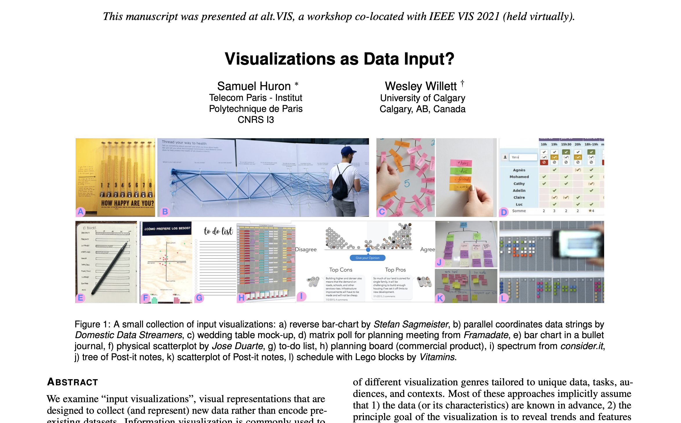

Slide 13
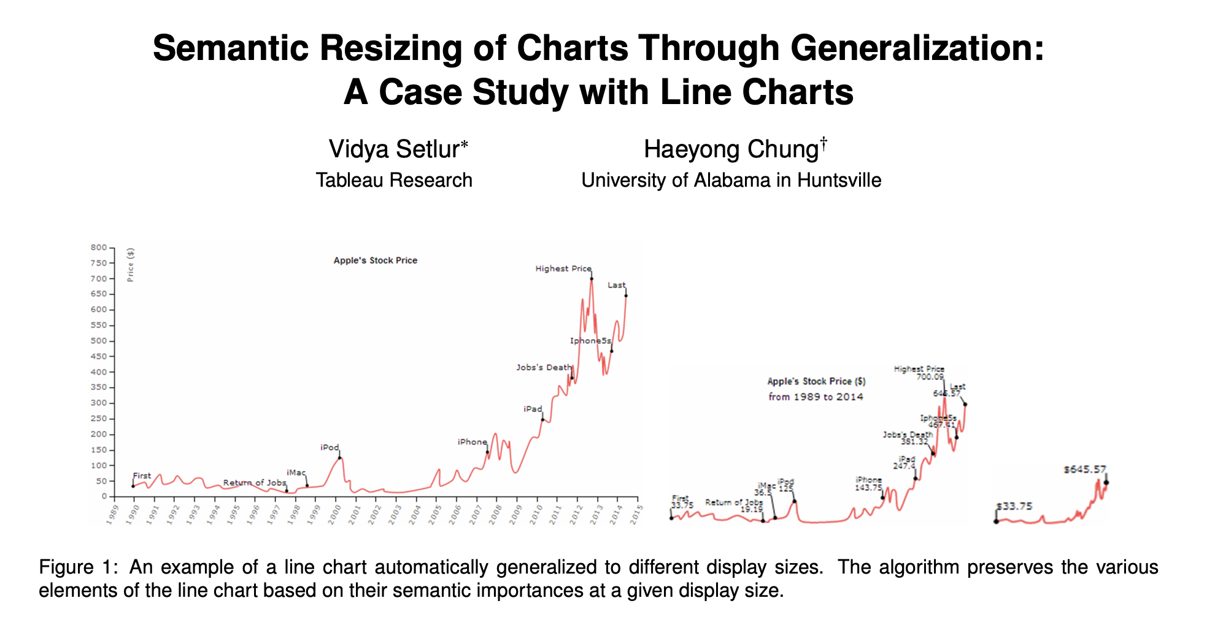

Slide 14
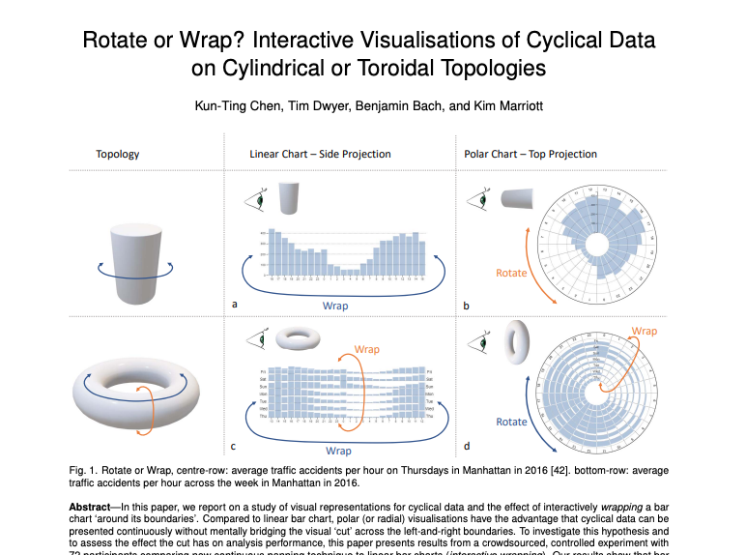
Wrappable Vis (monash.edu)

Slide 15
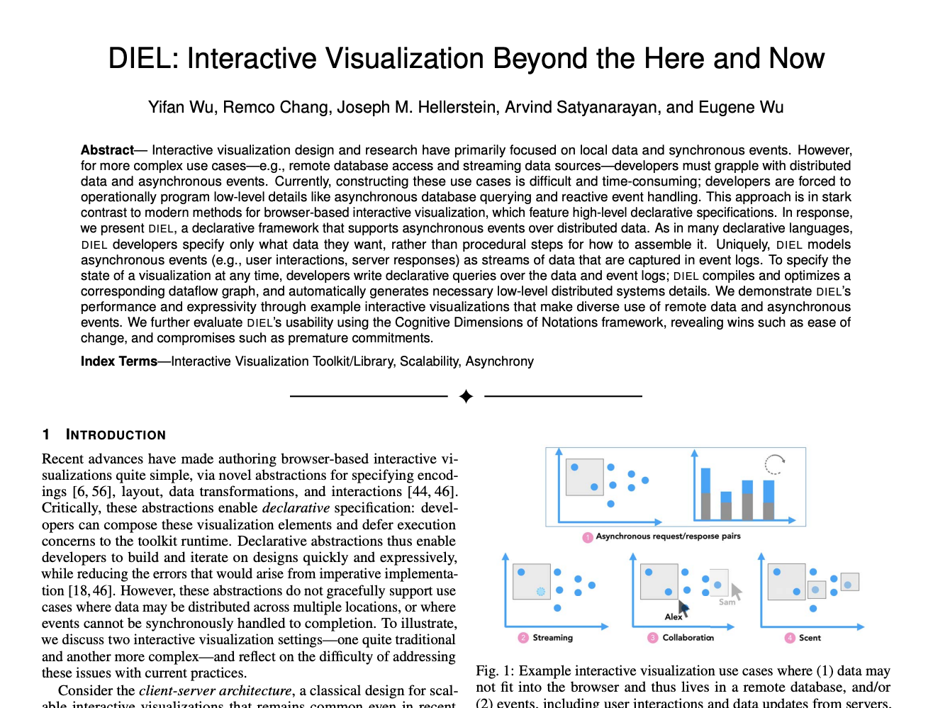

Slide 16

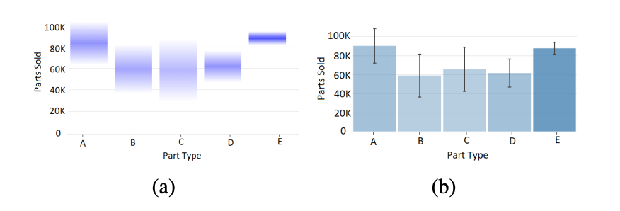

Slide 17
Each group assigns notetaker
What properties from AutoAdmin’s physical design problem are useful for optimizing human data interfaces? What aspects of its optimization problem do NOT apply?
Notes:
How did you pick the other vis language?

Slide 18

Support your colleagues
for speaking up!
2 Thumbs 4 SPEAKING UP

Slide 19
Each group assigns notetaker
What properties from AutoAdmin’s physical design problem are useful for optimizing human data interfaces? What aspects of its optimization problem do NOT apply?
Notes:
How did you pick the other vis language?

Slide 20
Class 13
Columnar Execution

Slide 21
Logistics
In-person-only on Nov 3 after election holiday
Spreadsheet assignment out!

Slide 22
Each group assigns notetaker
The reading mentioned column groups. What factors would determine the “best” column grouping?
Notes:
How did you pick the other vis language?

Slide 23
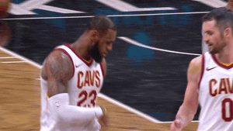
Support your colleagues
for speaking up!

Slide 24
Each group assigns notetaker
The reading mentioned column groups. What factors would determine the “best” column grouping?
Notes:
How did you pick the other vis language?

Slide 25
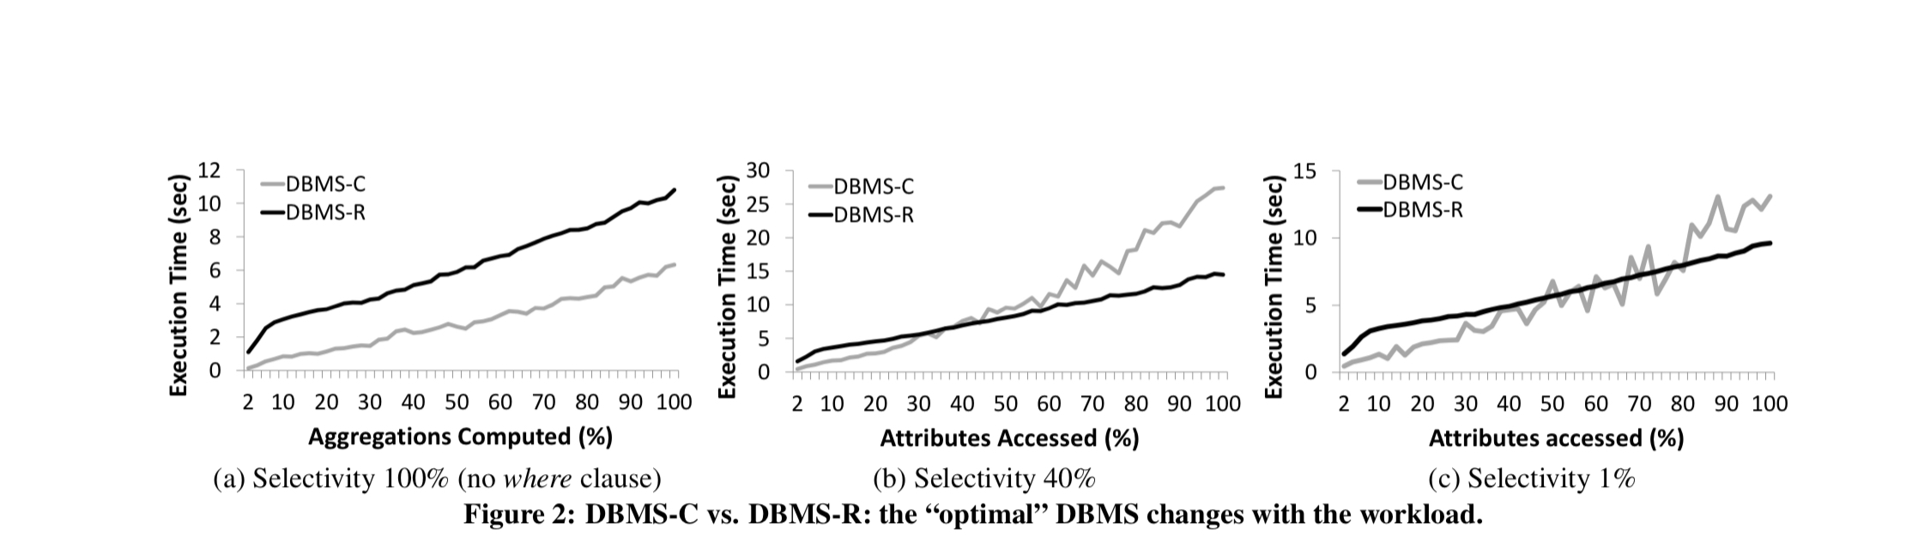
SELECT a, b, …. FROM data WHERE a > ? and b > ? and ….

Slide 26


Slide 27
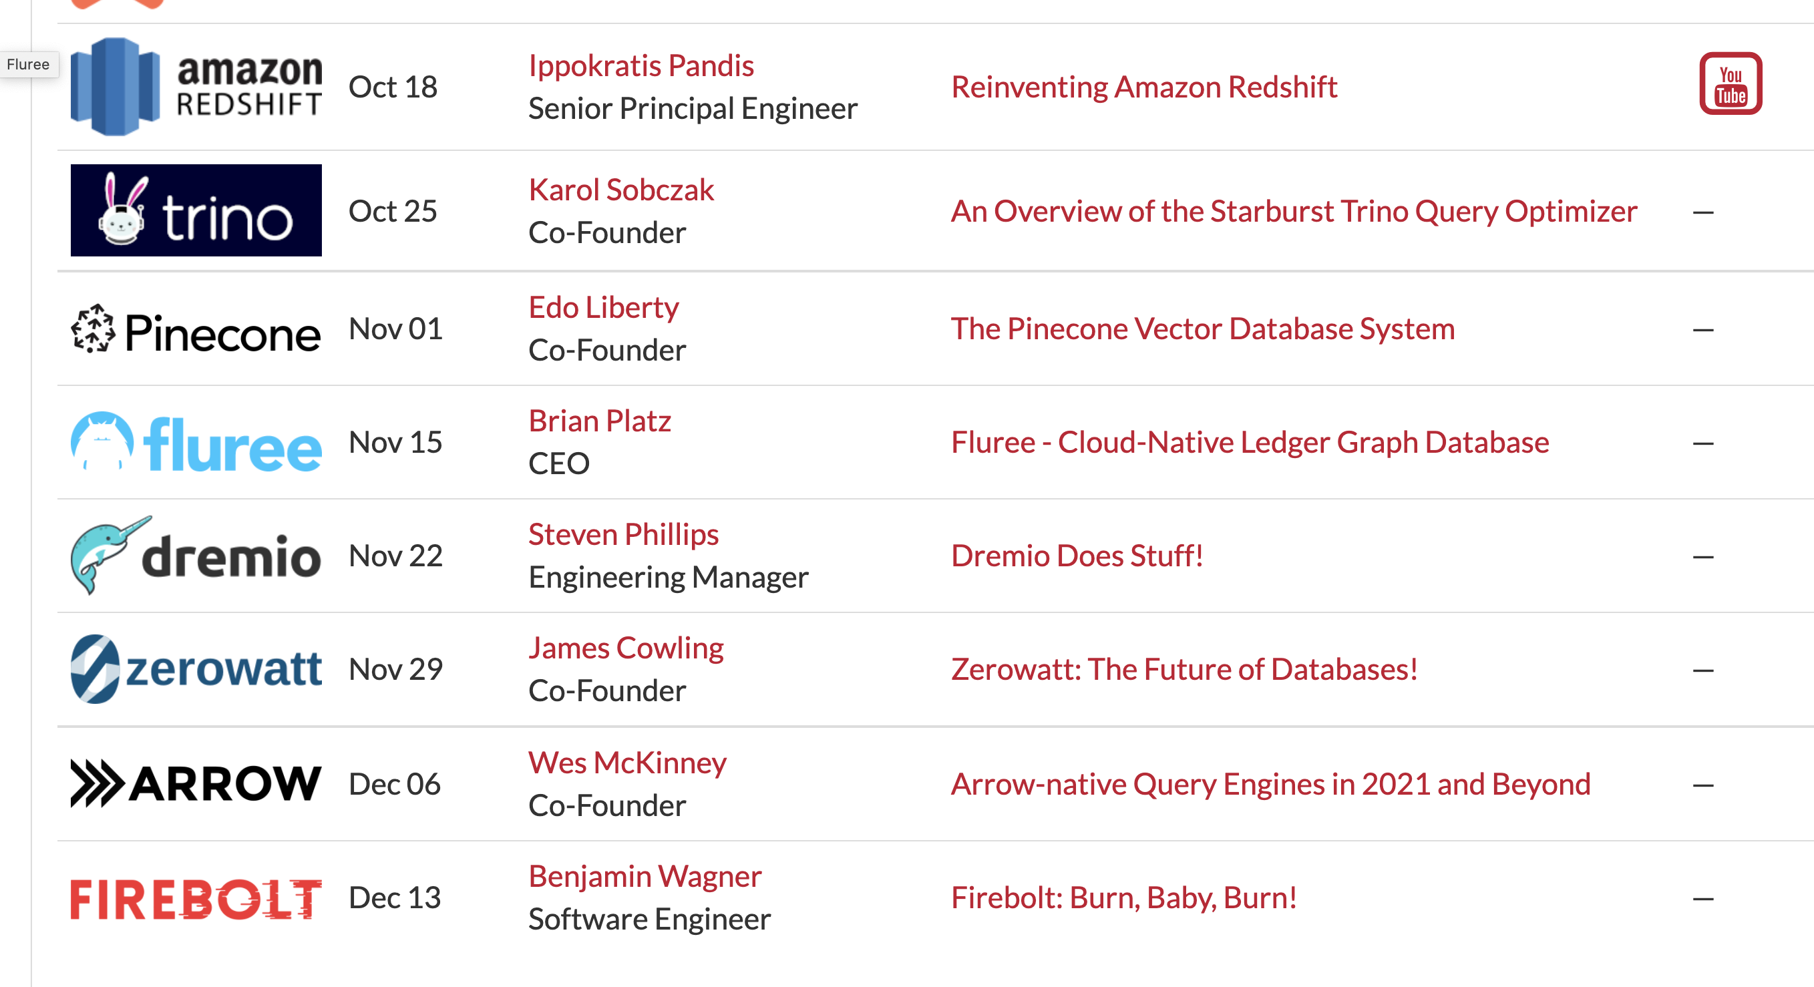

Slide 28
Class 12
Approximation and Materialization

Slide 29
Logistics
Haoran Pu discusses today’s readings
In-person-only on Nov 3 after election holiday
Spreadsheet assignment out Friday

Slide 30
Reviews
Sample creation takes a significant amount of time (5-30 minutes)… It doesn't seem like we would use BlinkDB for analytical workloads in which new data is always incoming.

Slide 31
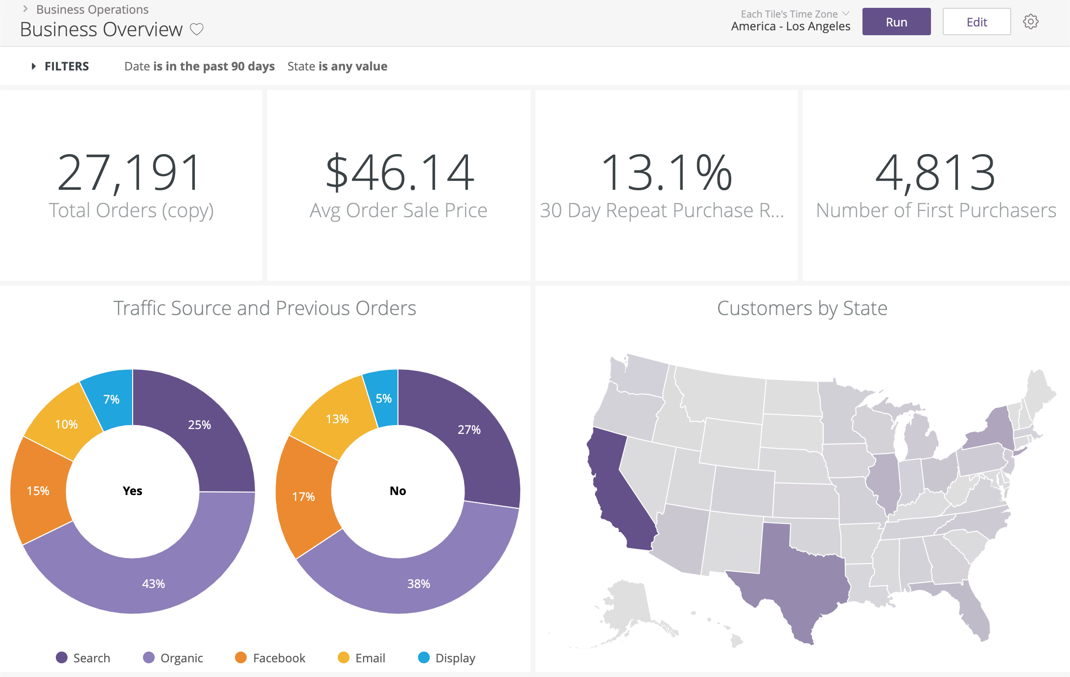
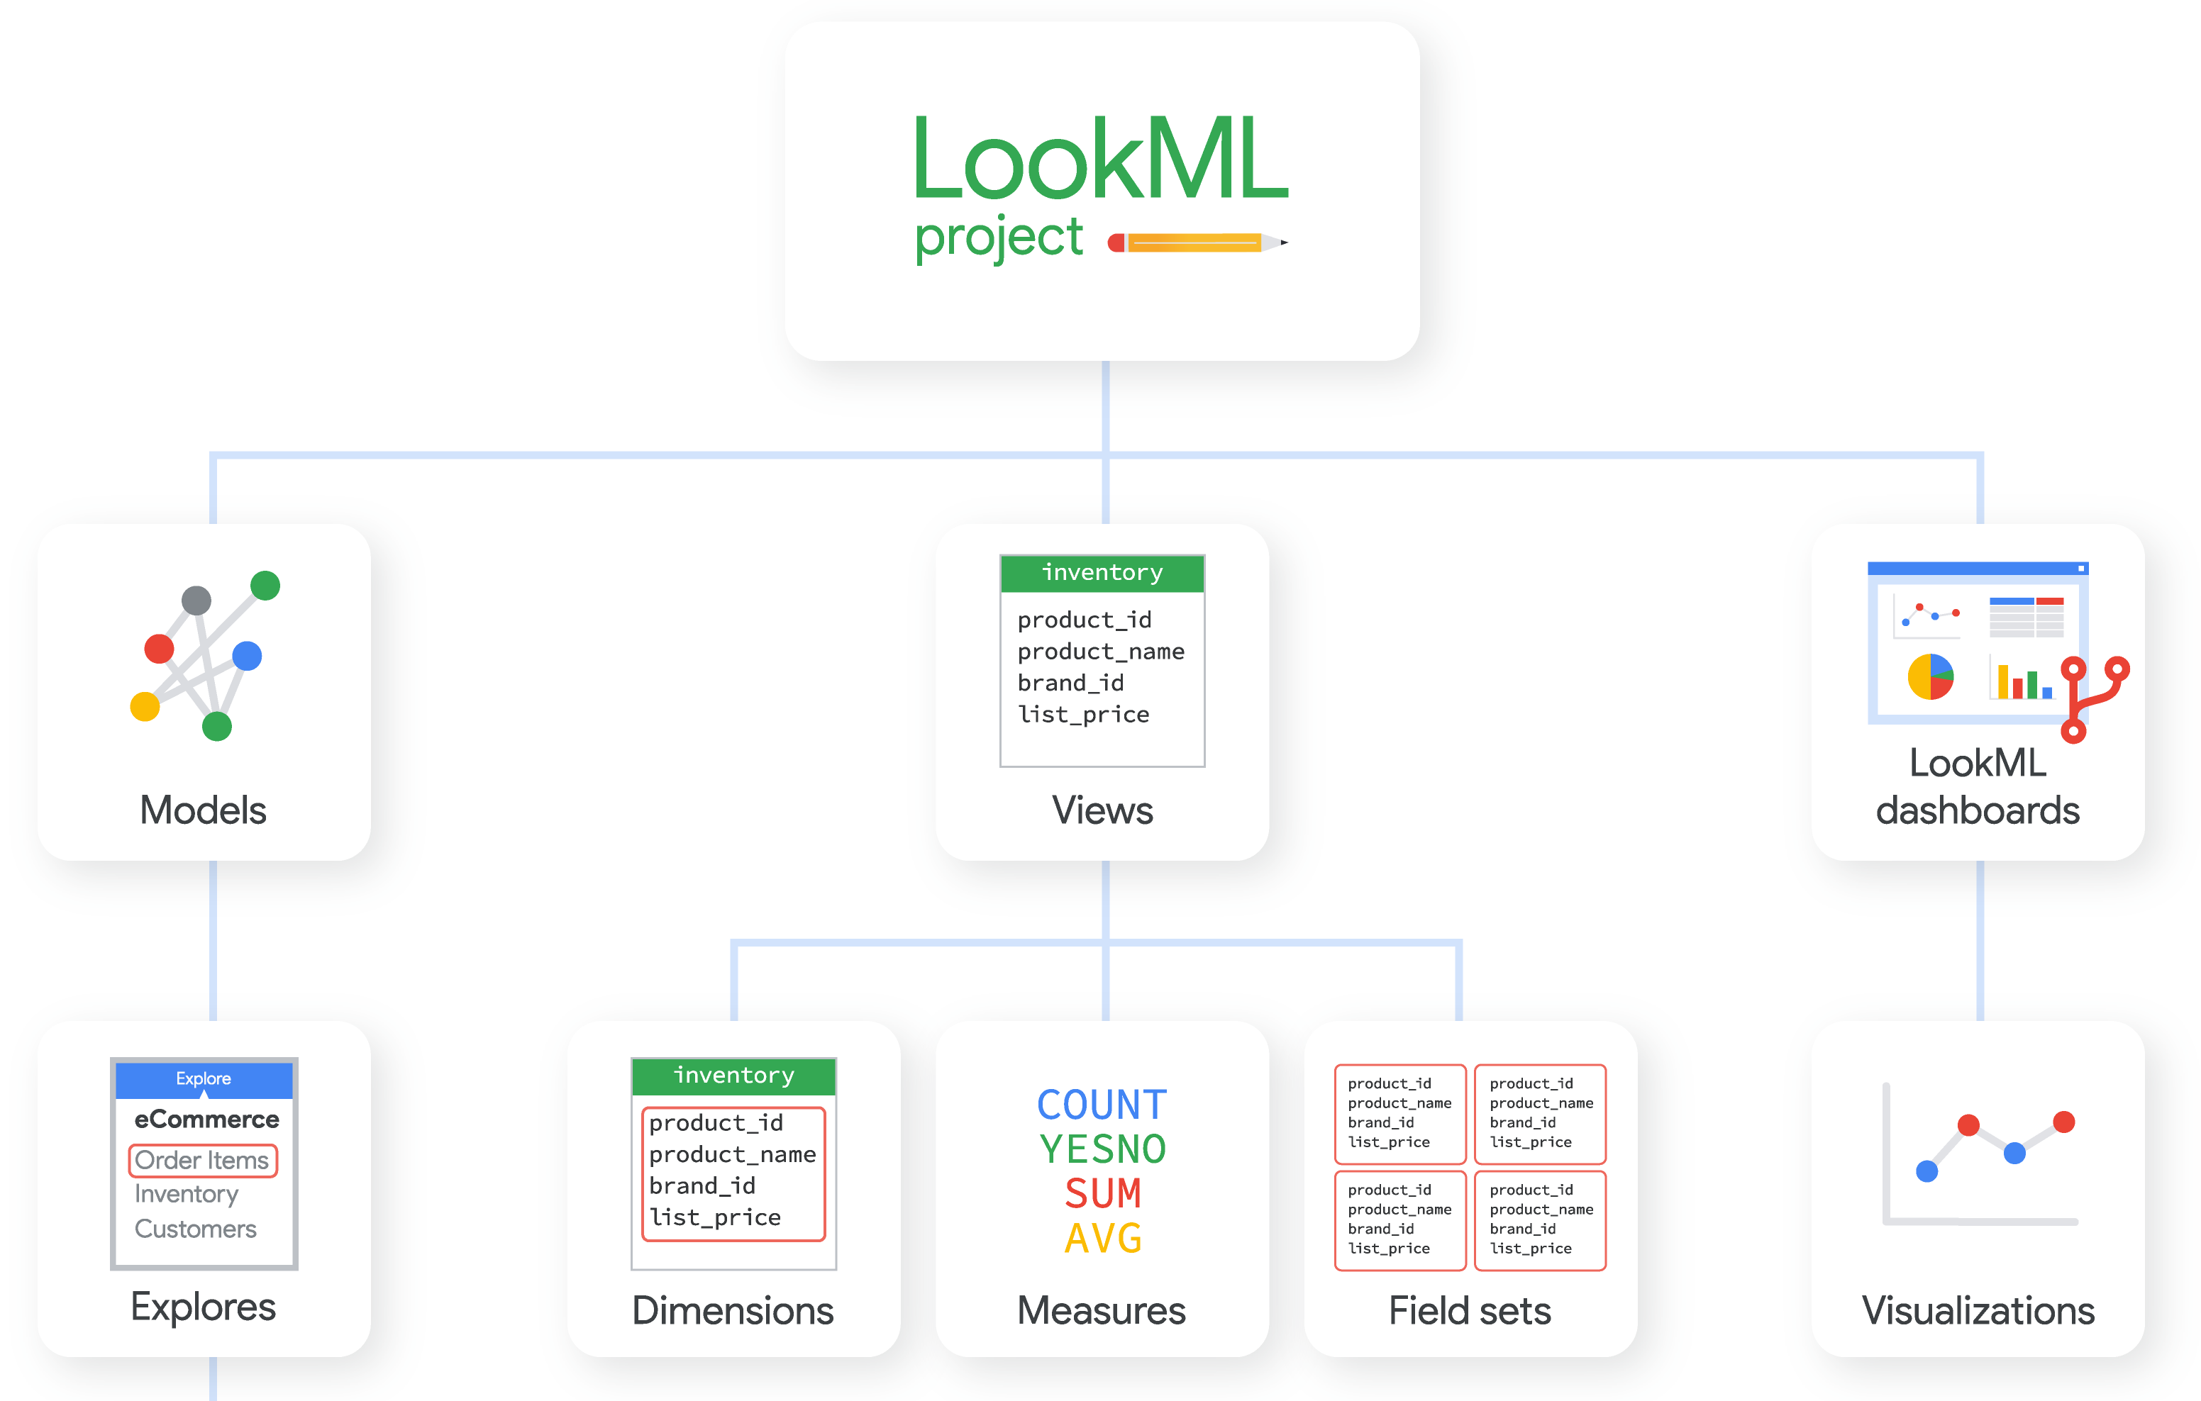
Reviews
Data cubes are no good for non-expert. As users have to define key measurements for the data cube. This means the interface user should be professional rather than a user who just wants to explore the data set.

Slide 32
Malloy from Looker
SQL is complete but ugly:
everything is expressible, but nothing is reusable;
simple ideas are complex to express;
the language is verbose and lacks smart defaults.
explore 'malloy-data.ecomm.order_items' | reduce
status
order_item_count is count(*)
https://github.com/looker-open-source/malloy

Slide 33
Each group assigns notetaker
What interface characteristics make approximation
more applicable than building data cubes (or vice versa)?
​Construct an example
Notes:
How did you pick the other vis language?

Slide 34

Support your colleagues
for speaking up!

Slide 35
Each group assigns notetaker
What interface characteristics make approximation
more applicable than building data cubes (or vice versa)?
​Construct an example
Notes:
How did you pick the other vis language?

Slide 36
Class 11
Optimization Overview and Col Stores

Slide 37
Logistics
Jeffrey Tao discusses today’s readings
In-person-only on Nov 3 after election holiday
Spreadsheet assignment out Friday

Slide 38
Projects
Main feedback
Hypothesis
Narrow scope
Related work
System
User Study
Hypothesis/Question
Interview

Slide 39
Projects
Main feedback
Hypothesis
Narrow scope
Related work
Not Here!
Start HERE!
System
User Study
Hypothesis/Question
Interview
Is it novel?
Is it worth asking?
Is it answerable?

Slide 40
Reviews
Data (model, size, shape)
Queries
Ops supported by interface
Formulas
Query structure/exec plan
User
What’s acceptable (acc, latency)?
What they want (deep vs wide?)
Preferences
Resources
To train user models, precompute, etc

Slide 41
Each group assigns notetaker
WHAT does the developer/user/system need to do
so the optimization system has the necessary information?
G1: to choose between materialized views and AQP?
G2: to know what the user wants/will do?
G3: to know what is acceptable?
Notes:
How did you pick the other vis language?

Slide 42

Support your colleagues
for speaking up!

Slide 43
Each group assigns notetaker
WHAT does the developer/user/system need to do
so the optimization system has the necessary information?
G1: to choose between materialized views and AQP?
G2: to know what the user wants/will do?
G3: to know what is acceptable?
Notes:
How did you pick the other vis language?

Slide 44
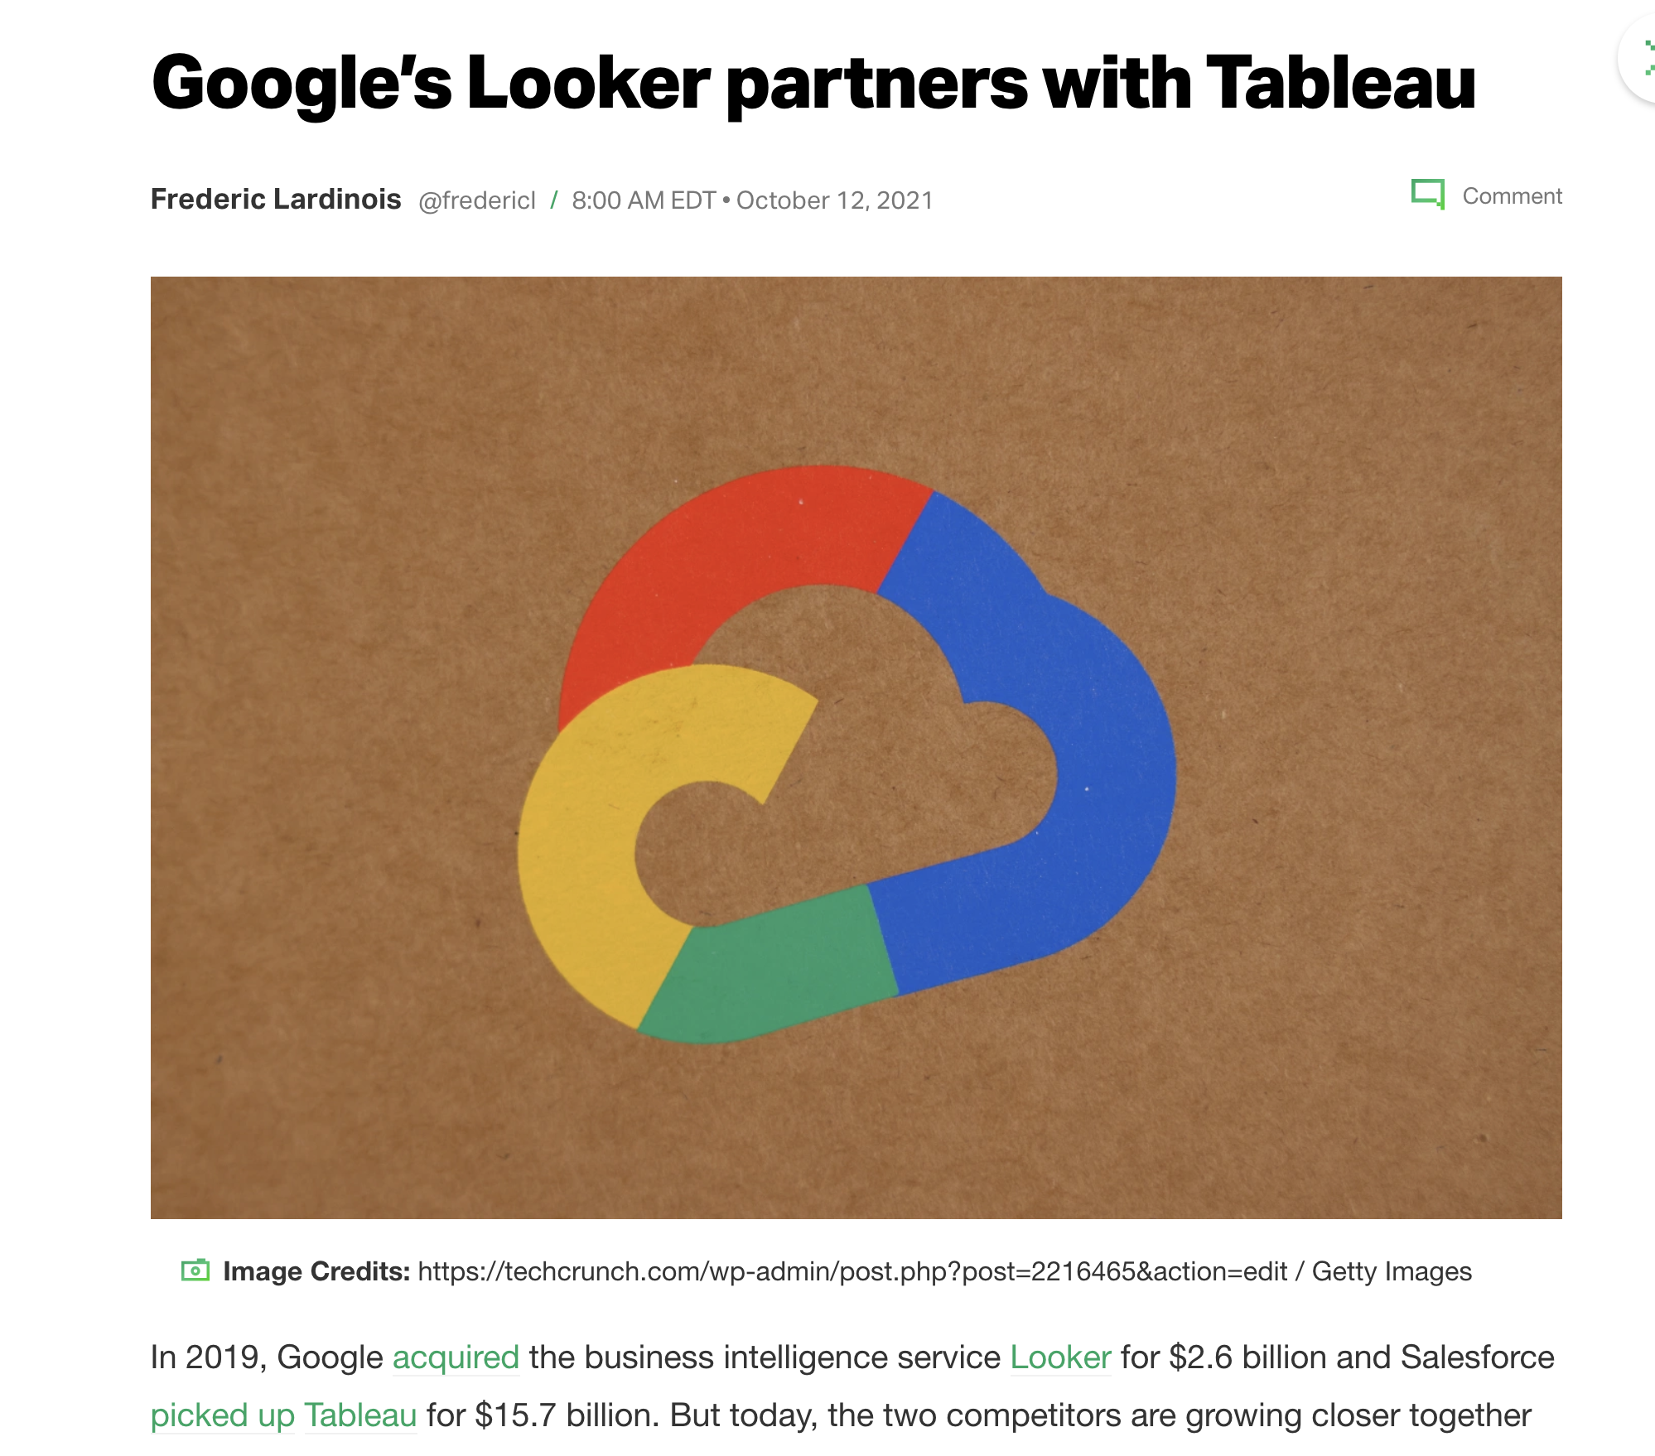

Slide 45
Class 10
Data Perspective on Data Interfaces

Slide 46
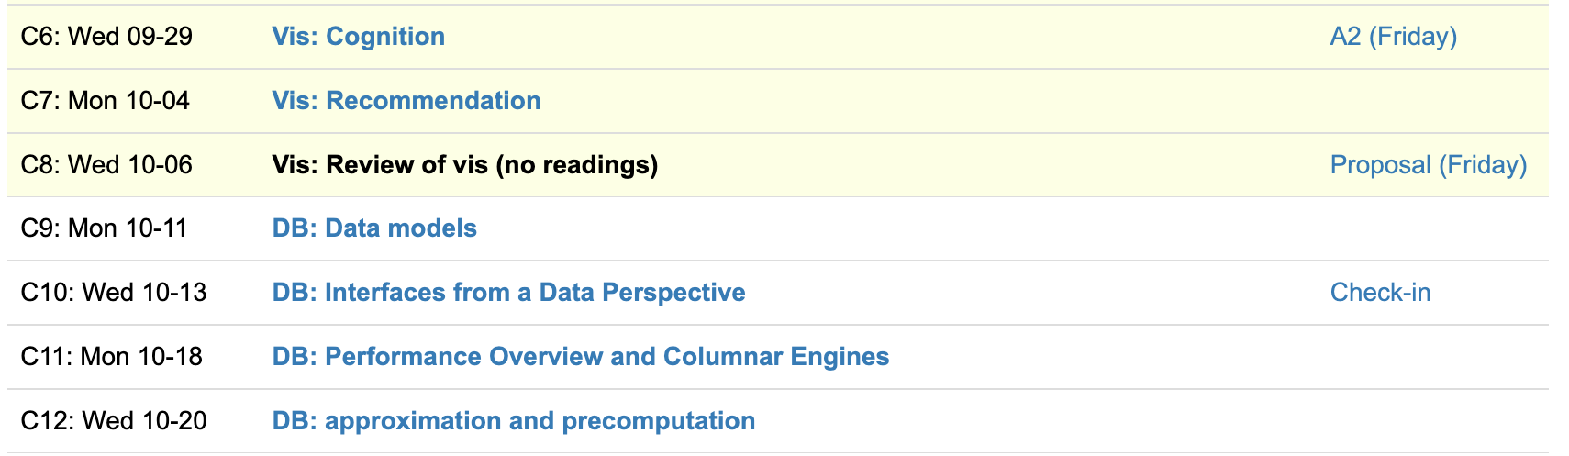
Logistics
Check-ins this week
Presentations starting next week
In-class or not? Votes lean toward in-class. Decision by Friday.

Slide 47
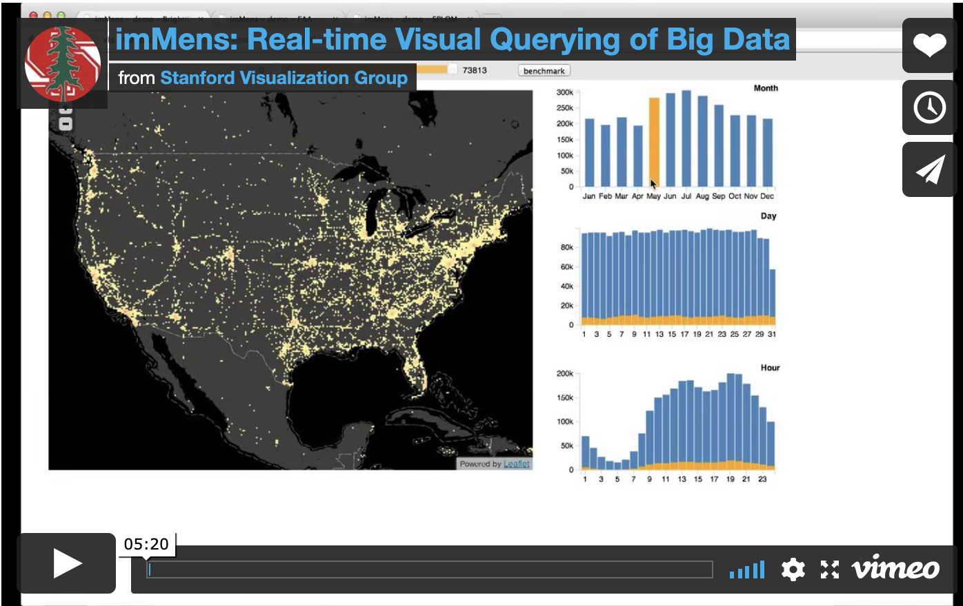
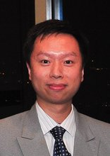
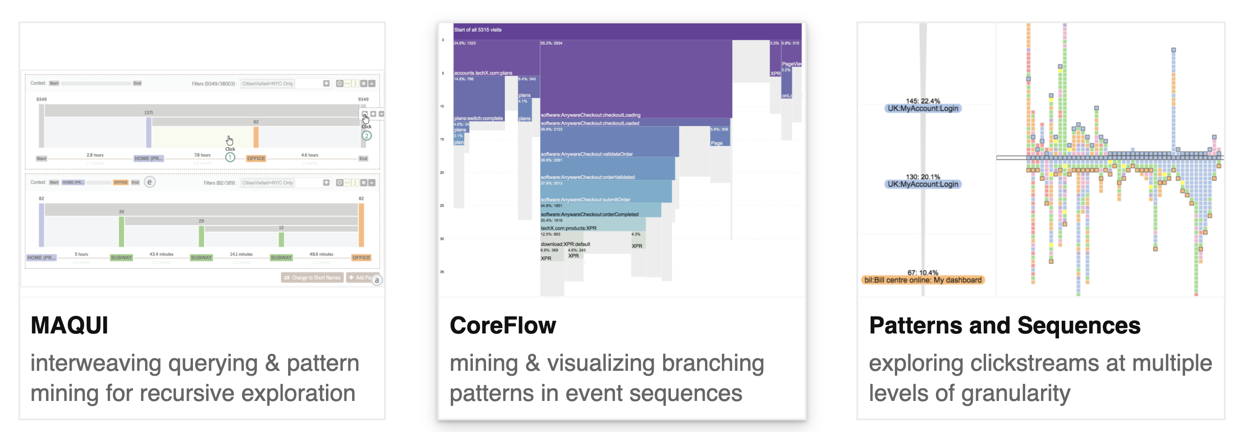
Leo Zhicheng Liu

Slide 48
Each group assigns notetaker
Where does Ermac draw the line between the visualization library and the database? Where does Tableau draw the line?
Notes:
How did you pick the other vis language?

Slide 49

Support your colleagues
for speaking up!

Slide 50
Each group assigns notetaker
Where does Ermac draw the line between the visualization library and the database? Where does Tableau draw the line?
Notes:
How did you pick the other vis language?

Slide 51
Class 9
Data Models

Slide 52
Logistics
Check-ins this week
Shifting to data processing topics
Midterm reviews
Review “grades” out tomorrow

Slide 53
Each group assigns notetaker
Identify an application or interaction that is hard to support under a relational model but easy to support under a non-relational model (specify what model).
Notes:
How did you pick the other vis language?

Slide 54

Support your colleagues
for speaking up!

Slide 55
Each group assigns notetaker
Identify an application or interaction that is hard to support under a relational model but easy to support under a non-relational model (specify what model).
Notes:
How did you pick the other vis language?

Slide 56
Class 8
Review/Breather

Slide 57
Turn video on,
enable mic

Slide 58
Logistics
Proposals due Friday
Sign up for Check-ins for next week (during OH and Thurs)

Slide 59
Each group assigns notetaker
Discuss a potential language for a domain we haven’t read about.
Consider the concepts covered in class so far
Notes:
How did you pick the other vis language?

Slide 60

Support your colleagues
for speaking up!

Slide 61
Each group assigns notetaker
Discuss a potential language for a domain we haven’t read about.
Consider the concepts covered in class so far
Notes:
How did you pick the other vis language?

Slide 62
Class 7
Recs

Slide 63
Turn video on,
enable mic
Is it winter already???
Discuss

Slide 64
Logistics
Proposals due Friday
No reviews Wednesday

Slide 65
Each group assigns notetaker
In human data interfaces, what should be the role of recommendations? What tasks?
Construct a scenario. Discuss the gaps wrt the readings.
Notes:
How did you pick the other vis language?

Slide 66

Support your colleagues
for speaking up!

Slide 67
Each group assigns notetaker
In human data interfaces, what should be the role of recommendations? What tasks?
Construct a scenario. Discuss the gaps wrt the readings.
Notes:
How did you pick the other vis language?

Slide 68
Class 6
Cognition

Slide 69
Turn video on,
enable mic
What is your favorite
sandwich (broadly construed)

Slide 70

CS Distinguished Lecture
Mon 10/4 11:30AM

Slide 71
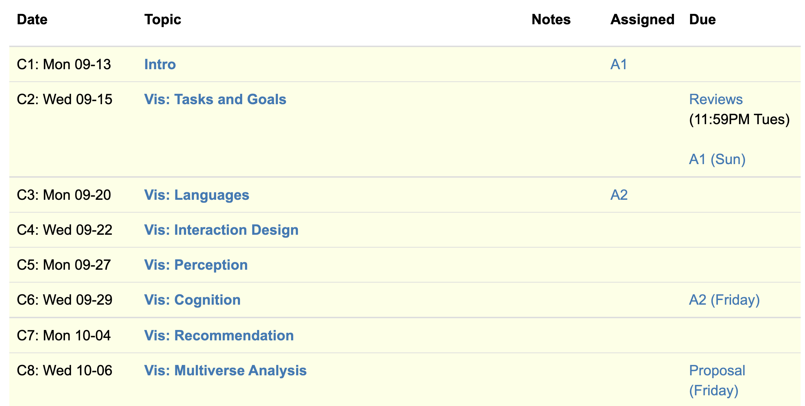
Logistics
A2 due Friday, Proposals next Friday
2nd guest speaker: Leo from Graphistry

Slide 72
Eirik Bakke: Spreadsheets

Slide 73
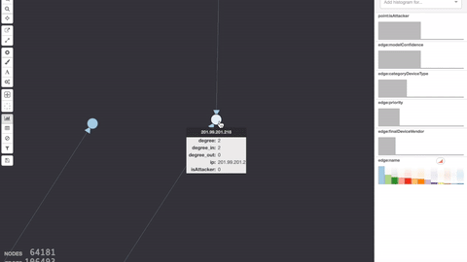
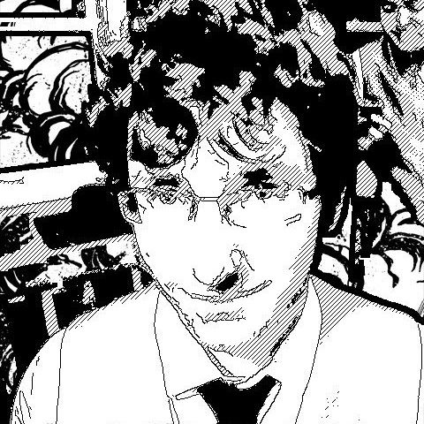
Leo Meyerov: Graph Analytics via GPU

Slide 74
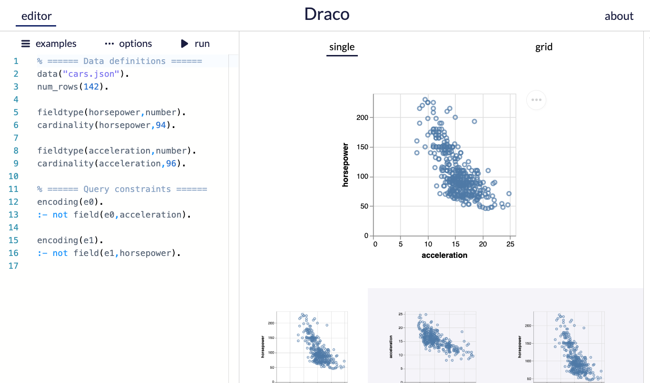
A2
Use the draco demo editor
Paper describes ASP language

Slide 75
Bridging Ideas and Reality
CS is (mostly) an engineering discipline
Ideas are ambiguous, many ways to ground in reality
“Draco could make data scientist lives better”
Project proposal: disambiguate.
Hypothesis formulation: a way to disambiguate

Slide 76
Overview. Research Project 50%
BAD
“We want to build X with features A, B, C”
Ignores why it’s worthwhile and new
Confuses artifact as the goal
GOOD
“Evidence shows Y is important, but existing work have a gap in X. We show that to fill the gap, A, B, and C and needed”
Grounded in related work and user needs
Explains why A, B, and C are necessary

Slide 77
Overview. Research Project 50%
BETTER
“Evidence shows that Y is imptnt, but existing work have a gap in X. ”
“If we do A, then we expect METRIC to CHANGE”
“If we do B, then we expect METRIC to CHANGE”
…

Slide 78
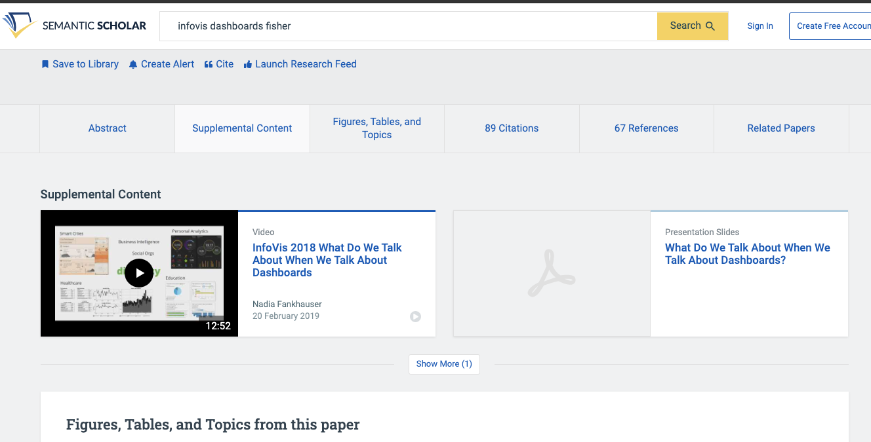

Slide 79
Each group assigns notetaker
This paper applied bayesian cognition to estimating a mean value. Identify another vis setting where the model could be applied. Formulate a hypothesis and sketch an experiment design.
Hypothesis: “Given conditions A, B is METRIC different?”
Notes:
How did you pick the other vis language?

Slide 80
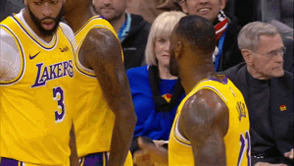
Support your colleagues
for speaking up!

Slide 81
Each group assigns notetaker
This paper applied bayesian cognition to estimating a mean value. Identify another vis setting where the model could be applied. Formulate a hypothesis and sketch an experiment design.
Hypothesis: “Given conditions A, B is METRIC different?”

Slide 82
Class 5
Perception

Slide 83
Turn video on,
enable mic
What’s your favorite restaurant
within a 20 min radius?

Slide 84
Logistics
A2 due Friday
Think about project proposal. 2 office hours left!

Slide 85
Projects
Build a system
Design an algorithm
Evaluate a design
Study perception/cognition
Survey
Etc.
Some project ideas

Slide 86
Today
Background:
Cleveland & McGill
AMT
Example of another perception experiment
The paper!

Slide 87
How complex?
uh...kind of complex?
Visualization Complexity Score
(this paper)
0.01
0.83
Visual complexity is subjective
Hard to articulate
Notes:
It is clear that the complexity of the chart can affect how easily , and accurately the user can extract information from the chart, at a glance.
We could imagine simplifying or zooming in or smoothing a line chart if it’s too complex, but we need to know that it IS too complex first. But what does complex even mean? Visual complexity can be subjective, and we can’t directy ask users to quantify it for us
This paper proposes ONE possible visualization complexity score, that takes a line chart as input and outputs a score that measures its perceptual complexity. For instance, a lower score for the simple horizontal line, and a higher number of a bunch of squiggles.

Slide 88
Adding Synthetic Noise
Notes:
In this experiment, we start with several simple, representative signals and measure their PAE. We see the line has very very low PAE, and it increases with the complexity of the signal.
We then add random synthetic noise to the signals, and see that the entropy correspondingly increases.
In fact, if we plot the amount of noise on the x axis, and the PAE on the Y axis, we see that there is a very strong correlation
Using this methodology, we find that PAE is correlated with synthetic noise. Now synthetic noise doesn’t necessarily correspond with perceived complexity

Slide 89
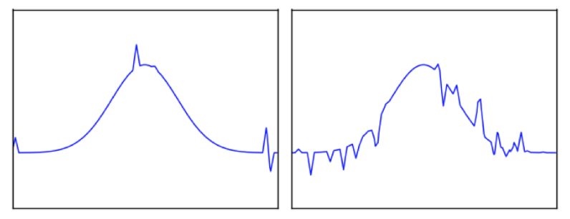
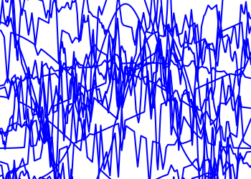
Task: Pick the Original
Glance time
Initial chart shown
Pause time
Mask shown
Pick time
User picks options
Notes:
If you glance over as the visualization changes, can you identify if something changed?
Mask to “clear the perceptual cache” to make sure its due to cognitive rather than low level perceptual pattern matching (after effects)
~3-4 seconds pick time in practice

Slide 90
Ready?
3
2
1

Slide 91
Pick the Original
Accuracy
Reduced
Increased
Change in PAE
Notes:
52 users, randomized order.

Slide 92
Pick the Original
Accuracy
Reduced
Increased
Change in PAE
Initial PAE

Slide 93
Pick the Original
Accuracy
Reduced
Increased
Change in PAE
Initial PAE
Notes:
It’s reminiscent of JND, but is not a formal staircase study
We also evaluated the effects of glance time and the results are reported in the paper.
(H3.1) Entropy of the initial chart (Z = 2.42, p < 0.05);
(H3.2) Magnitude of PAE difference between the two charts (Z = −5.08, p < 0.001);
(H3.3) Sign of the PAE dif- ference between the two charts (Z = −8.06, p < 0.001); and
(H3.4) Baseline function (χ2(3) = 9.32, p < 0.05).
There were 52 participants

Slide 94
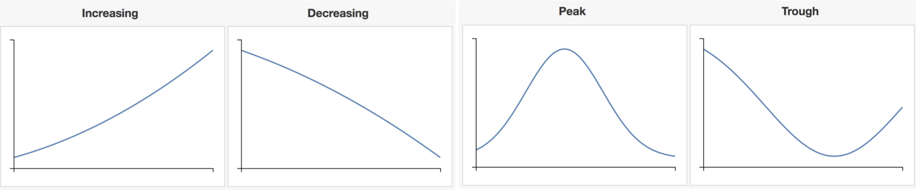
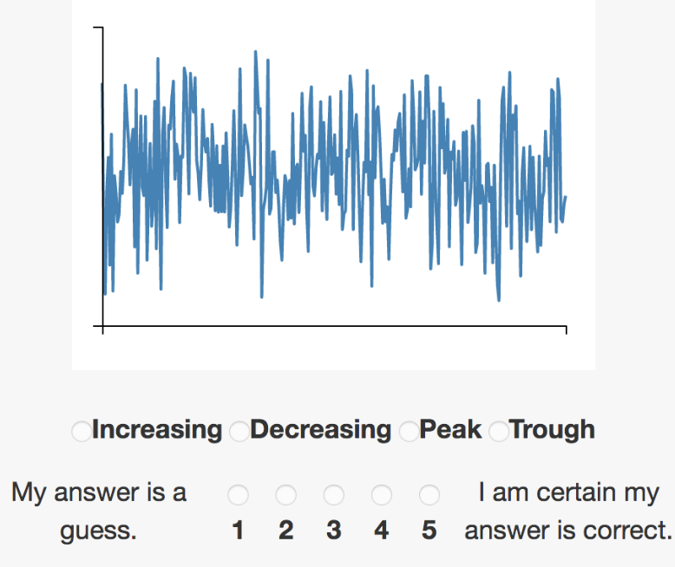
Pick The Signal
Which base function is most representative of chart?
Notes:
500ms glance time (2-4 fixations)
47 total participants,

Slide 95
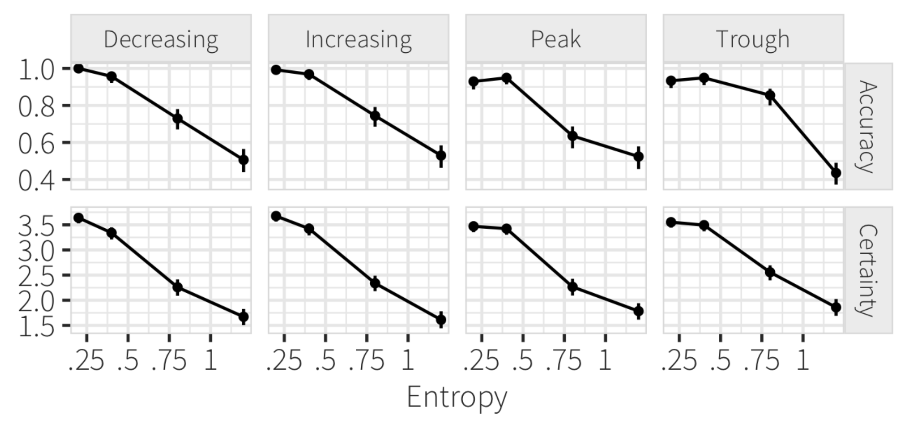
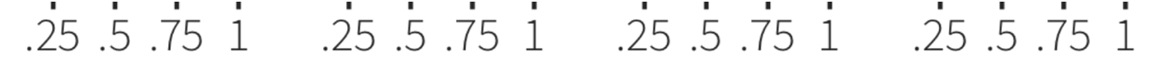
Pick The Signal
PAE
PAE
Notes:
significant results, with clearly high effect size (Z = 25.75, p < 0.001)
For each base function, we showed users 5 versions at each of four PAE levels (0.2, 0.4, 0.8, 1.2), resulting in a 4 × 4 × 5 = 80 factorial design.
There were 47 total participants,

Slide 96
Each group assigns notetaker
What would be a possible follow-up or alternative graphical perception study? Phrase it in the form of a question, and design an experiment for it.
Notes:
How did you pick the other vis language?

Slide 97
Support your colleagues
for speaking up!

Slide 98
Each group assigns notetaker
What would be a possible follow-up or alternative graphical perception study? Phrase it in the form of a question, and design an experiment for it.

Slide 99
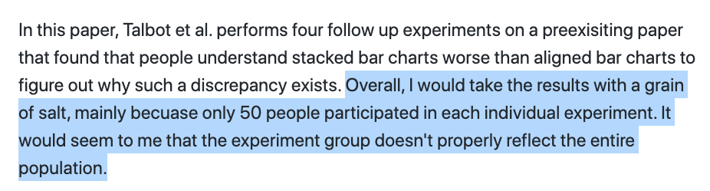

Slide 100
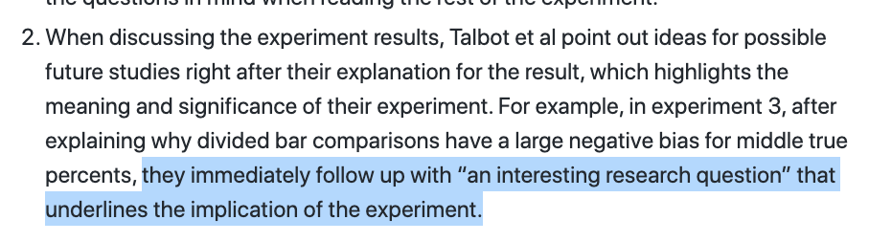

Slide 102
Class 4
Languages, Interaction

Slide 103
Turn video on,
enable mic
Share a book you recently
read/listened to

Slide 104
Logistics
A2 released.
Think about project proposal. 2 office hours left!

Slide 105
Each group assigns notetaker
G1: How does the instrumental interactions model apply to interactive visualizations?
G3, 4: Where do interface languages fit into the instrumental interactions model?
Notes:
How did you pick the other vis language?

Slide 106

Support your colleagues
for speaking up!

Slide 107
Each group assigns notetaker
G1, 2: How does the instrumental interactions model apply to interactive visualizations?
G3, 4: Where do interface languages fit into the instrumental interactions model?

Slide 108
Interactive Interfaces as Domain Specific Languages

Slide 110
Class 3
Languages

Slide 111
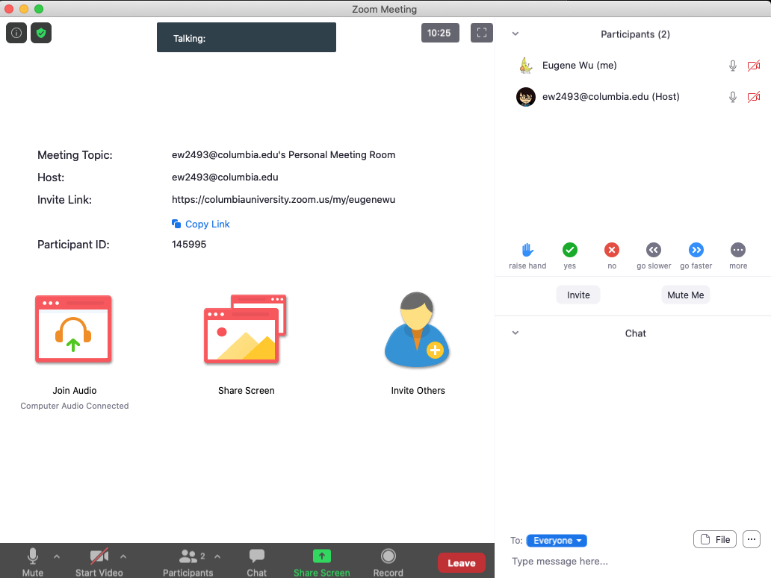

Turn video on,
enable mic & say:
“Hi, this is _(name)_,
I usually eat ________ for lunch”
Click when done
Participants
Chat

Slide 112
Logistics
A1 was due last night
A2 released.

Slide 113
Each group assigns notetaker
G1 and 2: What criteria makes a HDI language good? Put the criteria into action: pick a domain/task and make up a language.
G3 and 4: discuss the strengths and weaknesses of how the paper is communicated. Share the top strength and top weakness.
Notetaker shares what you came up with and the process.
Notes:
How did you pick the other vis language?

Slide 114
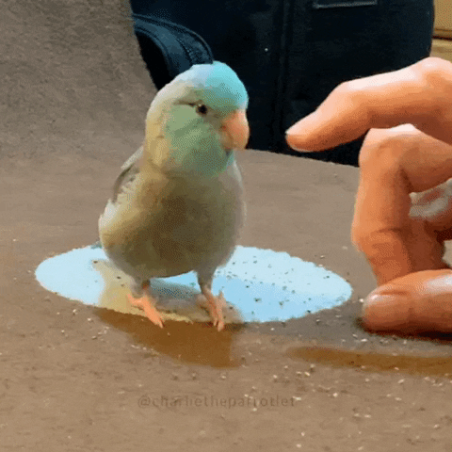
Support your colleagues
for speaking up
A quick thanks or follow up
is great

Slide 115
Each group assigns notetaker
G1 and 2: What criteria makes a HDI language good? Pick a domain/task and come up with a language.
G3 and 4: discuss the strengths and weaknesses of how the paper is communicated. Share the top strength and top weakness.
Notetaker shares what you came up with and the process.

Slide 116
Technique
Is it correct?
Does it make sense?
Is it as simple as possible?
Are decisions unnecessarily complex?

Slide 117
Comunication
What is the appropriate audience?
How well do they justify
Design decisions?
Technical approach?
The problem itself?

Slide 118
Experiments
What SHOULD have been done?
How should it be measured?

Slide 119
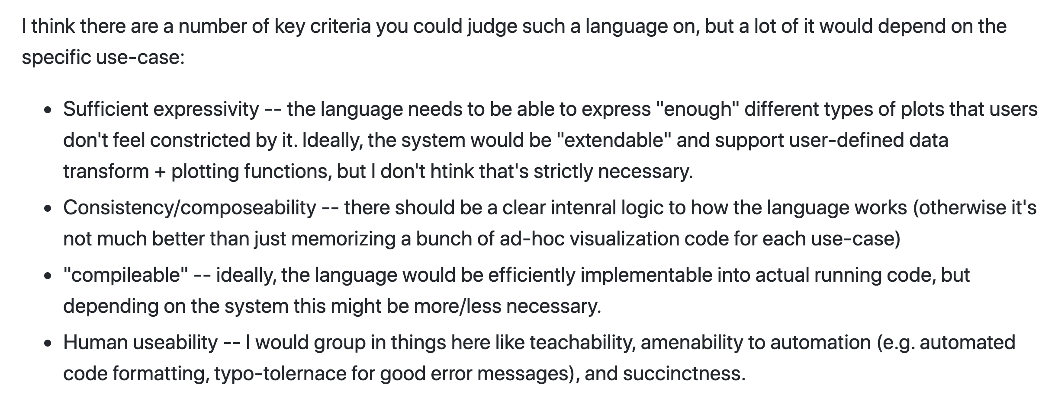

Slide 120
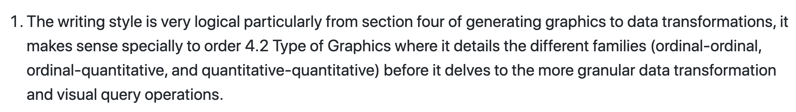

Slide 121
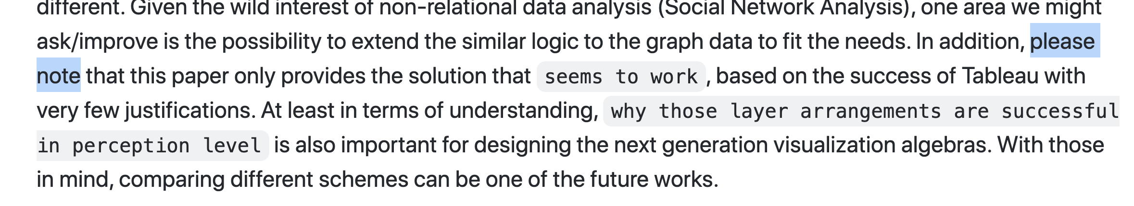

Slide 122
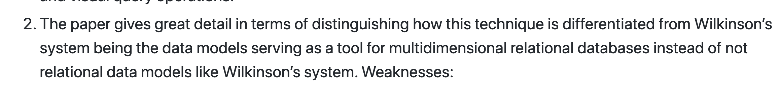

Slide 123
Class 2
Tasks

Slide 124
Discussion prompt:
Recent book that you find memorable

Slide 125


Slide 126
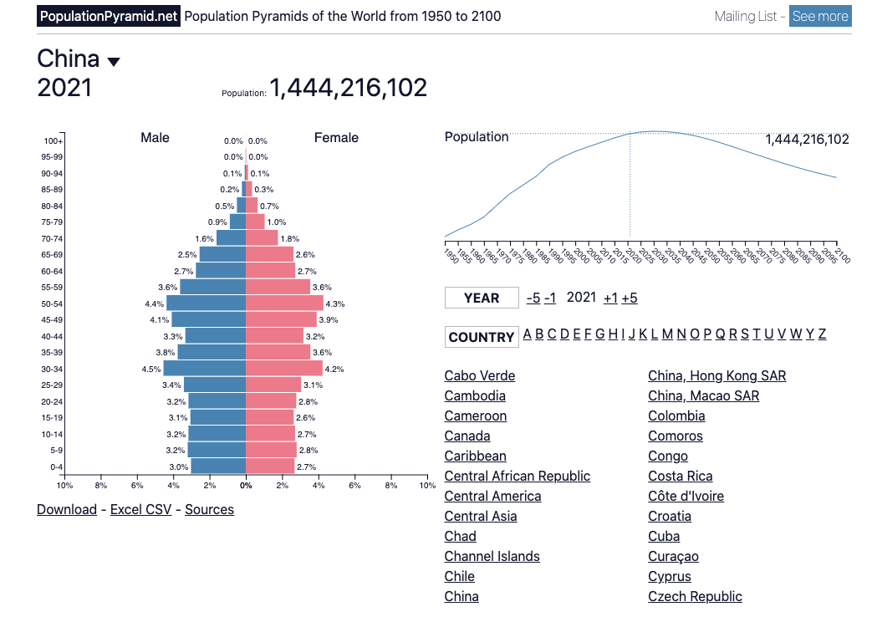

Slide 127
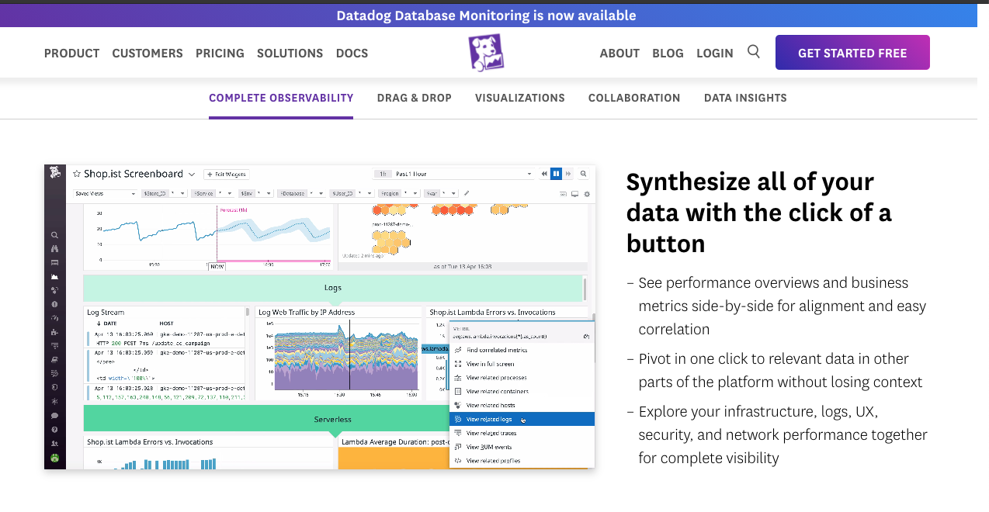

Slide 128
Each group assigns notetaker
Groups of 4:
You back-fitted task descriptions from a visualization. Discuss your process, what made it easy/difficult, and reflect on the applicability of the task typology.
Bonus, choose a visualization and task to share with the class. (connect to zoom, share screen)

Slide 129
Support your colleagues
for speaking up
A quick thanks or follow up
is great

Slide 130
Each group assigns notetaker
Groups of 4:
Discuss and share the visualization and task description you created in the review.
Choose one that notetaker will share with the class
(connect to zoom, share screen)

Slide 131
TODOs
A1!!

